Slide 1
Cinq idées sur l’urgence écologique et la désobéissance civile
Graeme Hayes (Aston University)
La Rochelle Université
le 25 mai 2023

Slide 2
Cinq idées sur l’urgence écologique et la désobéissance civile
1. Définitions

Slide 3
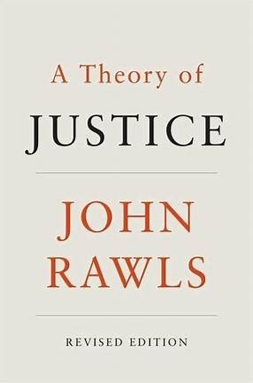
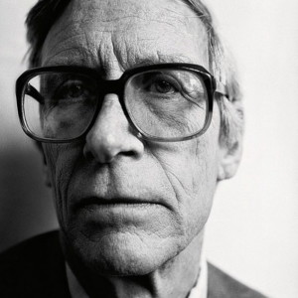

Slide 4
Les conditions de la désobéissance civile selon Rawls
dans une société « presque juste »
un acte politique et public
nonviolent et citoyen
efficace et de dernier ressort
dans le respect de l’Etat de droit
et des conditions de la coopération sociale
Notes:
Each of these conditions is necessary; none alone are sufficient
a political act addressed to the sense of justice of the majority
civil, or nonviolent, as it is an appeal to the principles of justice, the fundamental condition of social cooperation
public, undertaken in respect for legal procedure
as a condition of sincerity and conscience
restricted to fundamental rights – the conditions of fairness, equality, freedom – issues which define the status of citizenship
effective, in that it must reasonably address the issue being protested
a last resort, where all other forms of available democratic redress have been exhausted

Slide 5
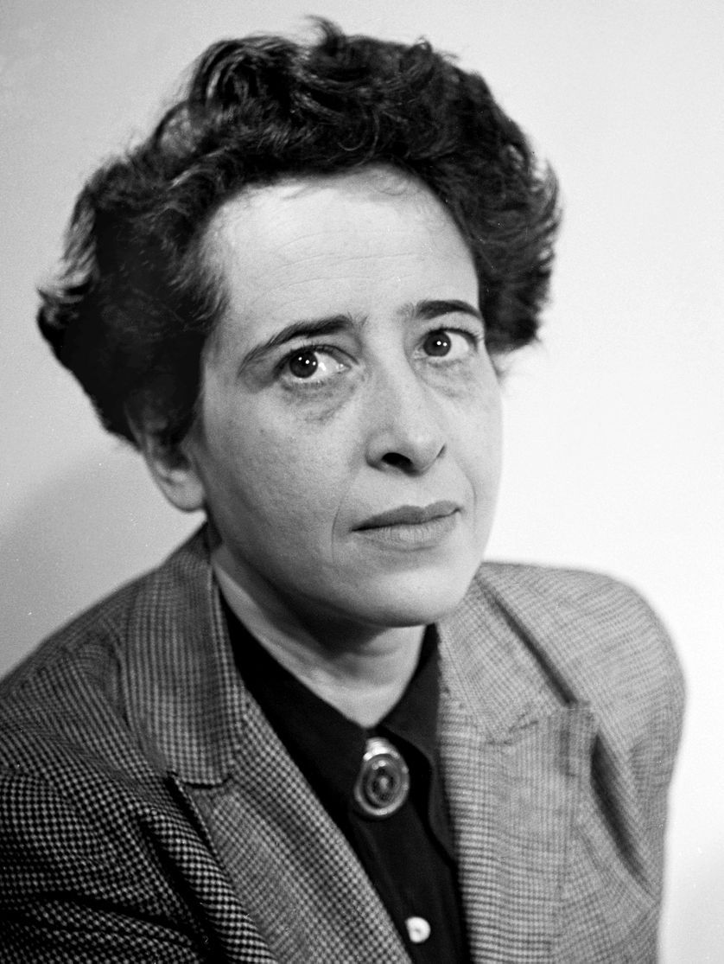
organized minorities, bound together by common opinion, rather than by common interest, and the decision to take a stand against the government’s policies even if they have reason to assume that these policies are backed by a majority
Hannah Arendt, Crises of the Republic, 1973

Slide 6
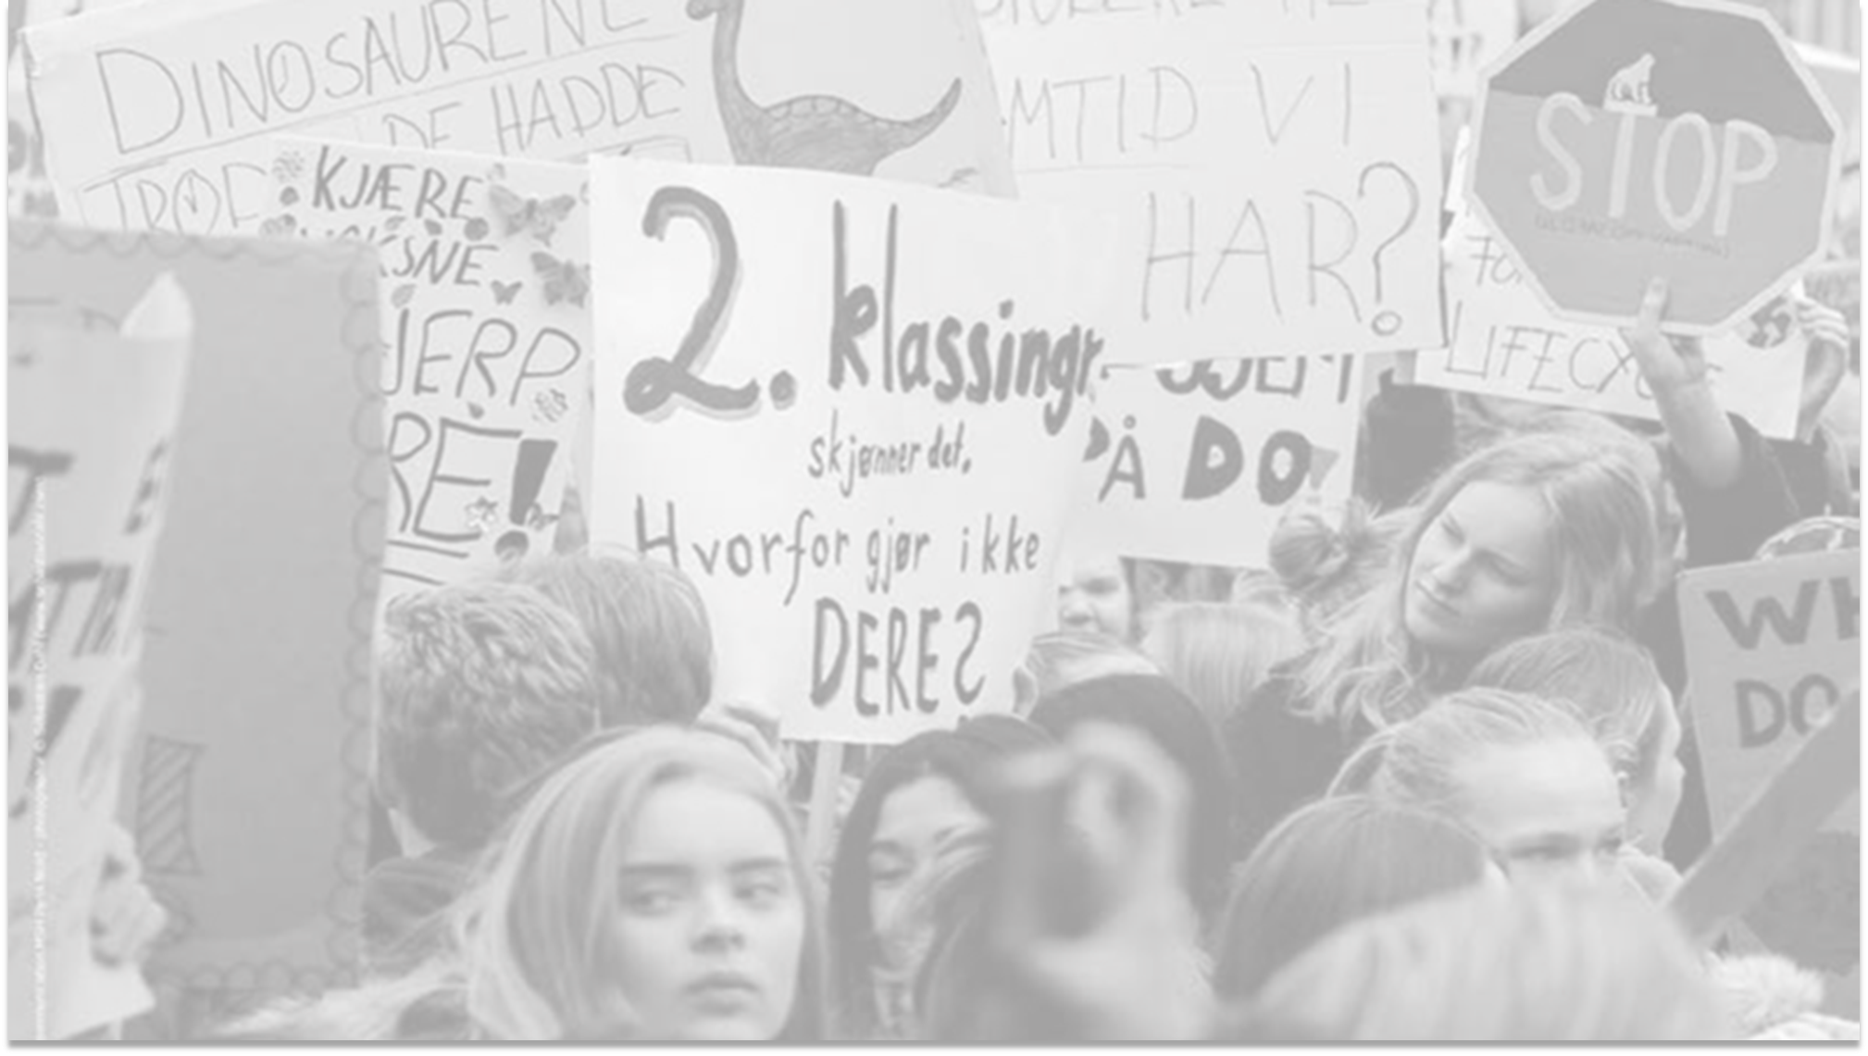
Cinq idées sur l’urgence écologique et la désobéissance civile
2. Actions

Slide 7
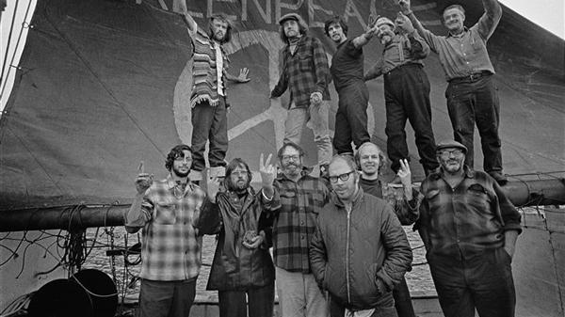
Témoignage
Notes:
The crew of the Phyllis Cormack (also called "Greenpeace") on-board the ship. Clockwise from top left: Hunter, Moore, Cummings, Metcalfe, Birmingham, Cormack, Darnell, Simmons, Bohlen, Thurston, Fineberg. This is a photographic record by Robert Keziere of the very first Greenpeace voyage, which departed Vancouver on the 15th September 1971. The aim of the trip was to halt nuclear tests in Amchitka Island by sailing into the restricted area. Crew on-board the ship, are the pioneers of the green movement who formed the original group that became Greenpeace.

Slide 8
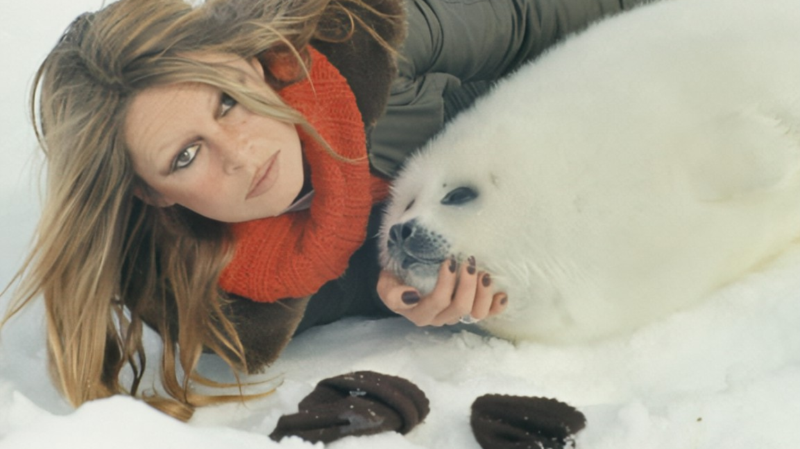
Notes:
Brigitte Bardot and a baby seal
Brigitte Bardot, holding a baby seal, during Greenpeace's campaign against the seal hunt, on the Labrador ice floes, Canada, 1st March 1977

Slide 9
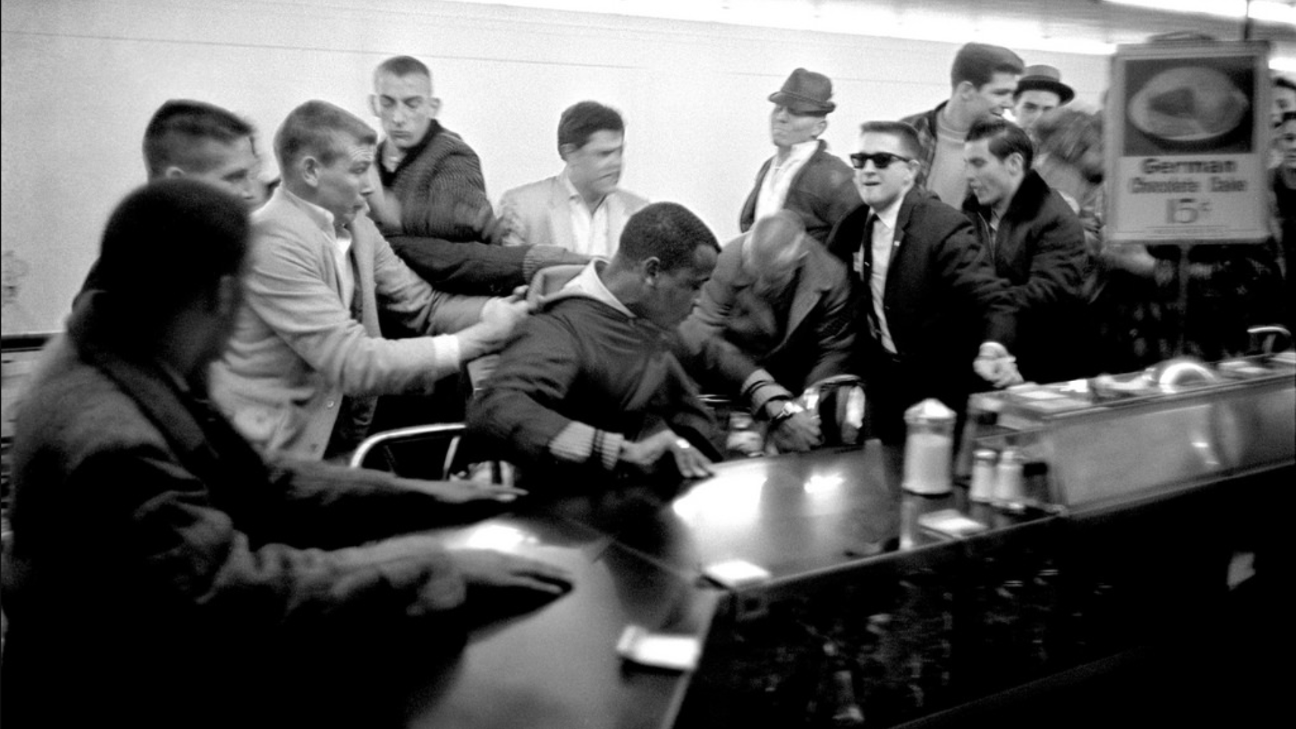
Blocage
Notes:
Nashville, 1960
On February 13, 1960, 500 students from Nashville’s four Black colleges—Fisk University, Tennessee State, Meharry Medical, and the Baptist Seminary—filed into the downtown stores to request service at segregated establishments. White merchants refused to serve the Black students and petitioned the police to arrest them for “trespassing” and “disorderly conduct.” On February 26, the chief of police warned student demonstrators that their “grace period” was over and threatened legal retaliation. The demonstrators were not dissuaded.

Slide 10
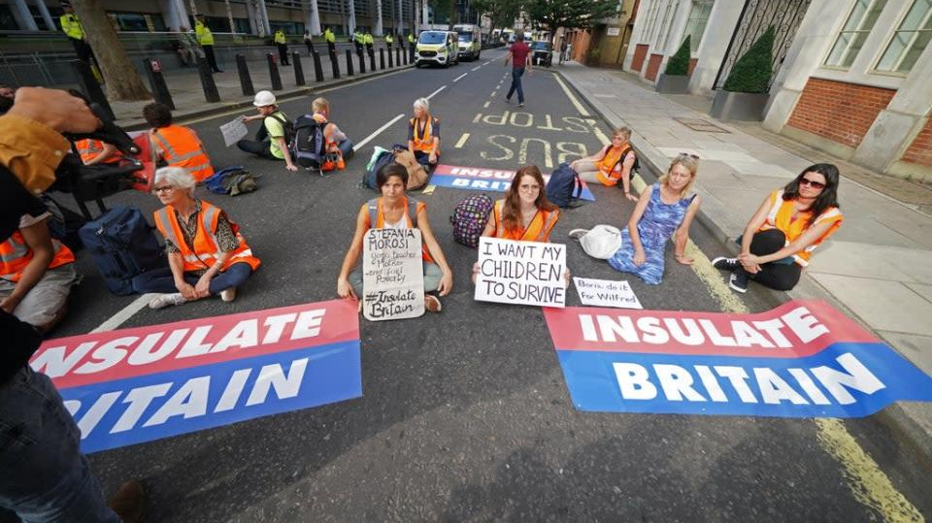

Slide 11
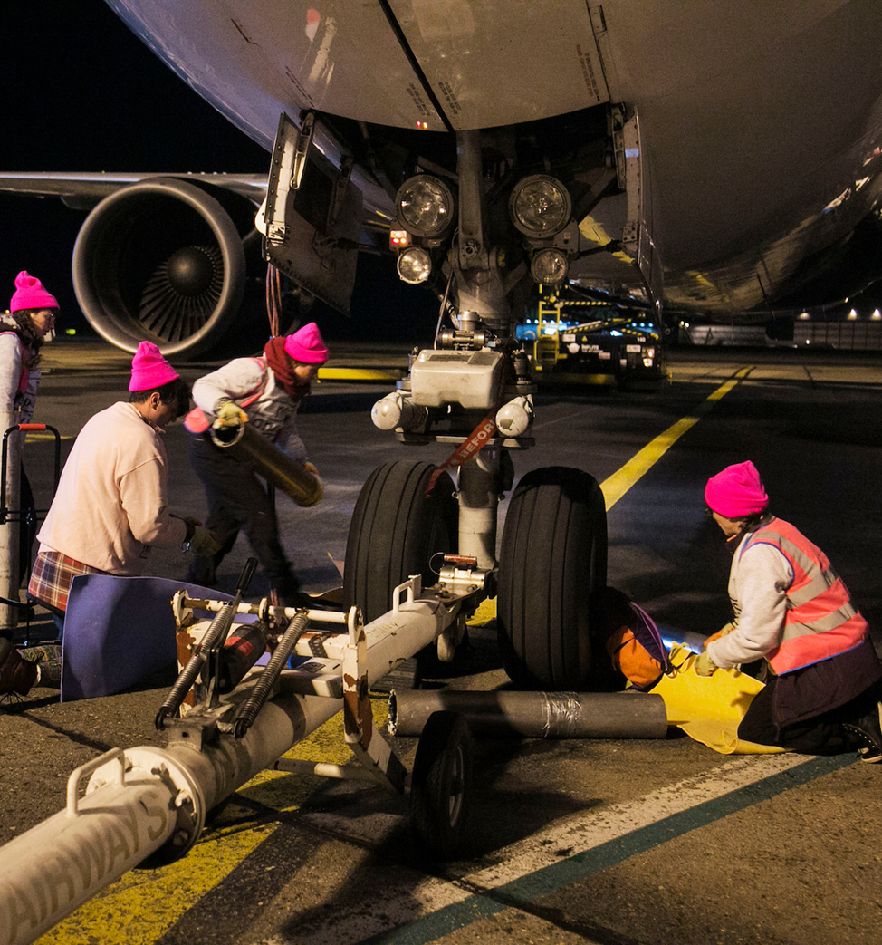
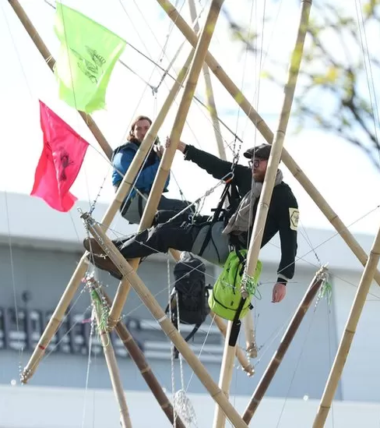
vulnérabilité fabriquée

Slide 12
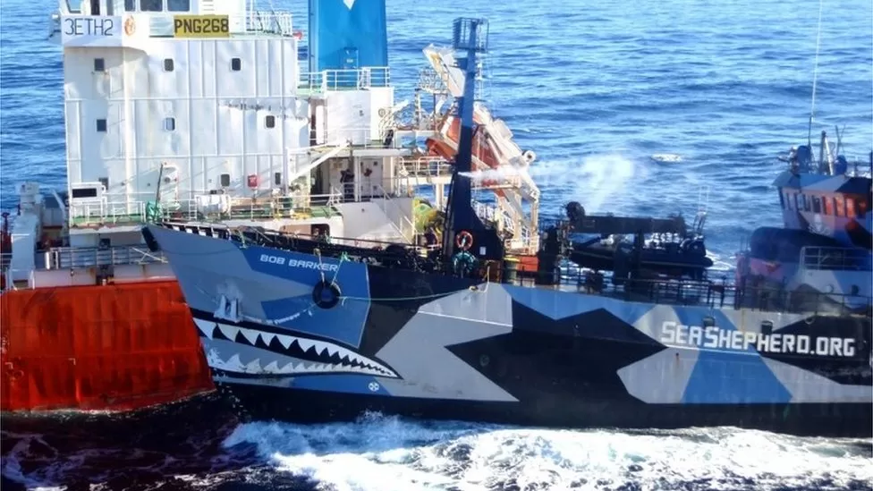
Notes:
Blocage

Slide 13
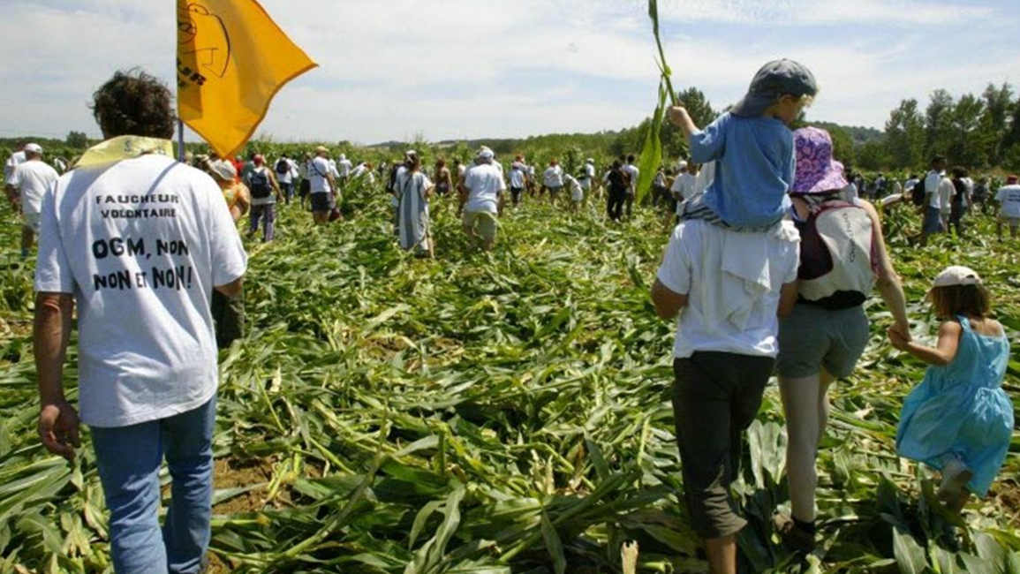
Sabotage

Slide 14
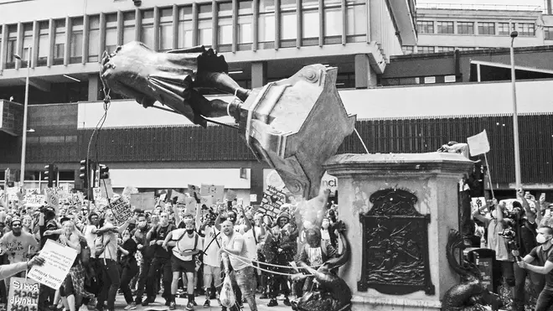
Notes:
Bristol June 2020

Slide 15
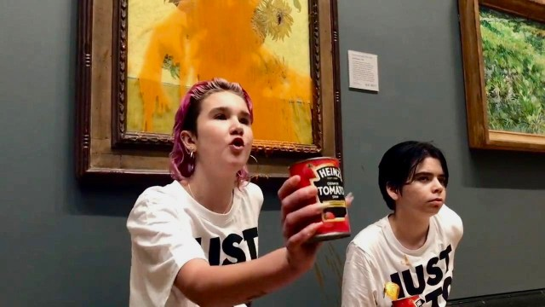

Slide 16
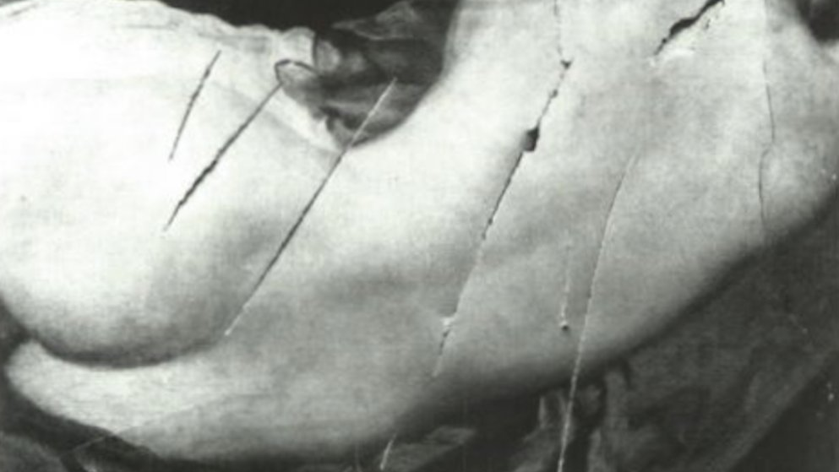

Slide 17
Cinq idées sur l’urgence écologique et la désobéissance civile
3. Traditions

Slide 18
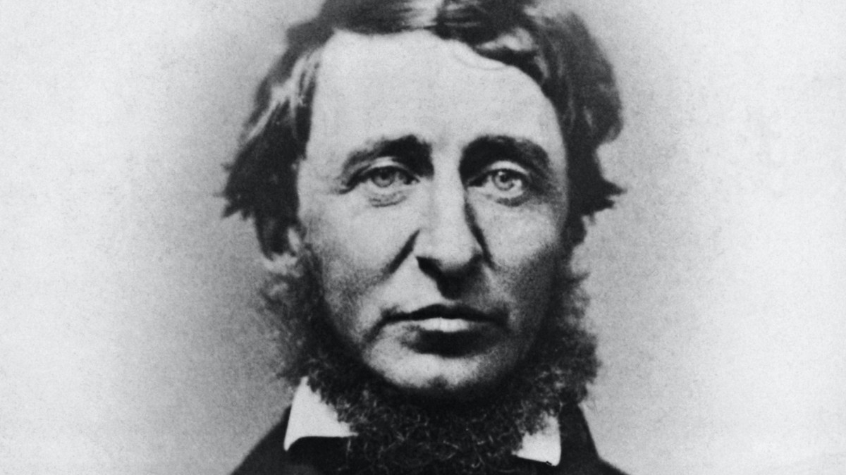

Slide 19
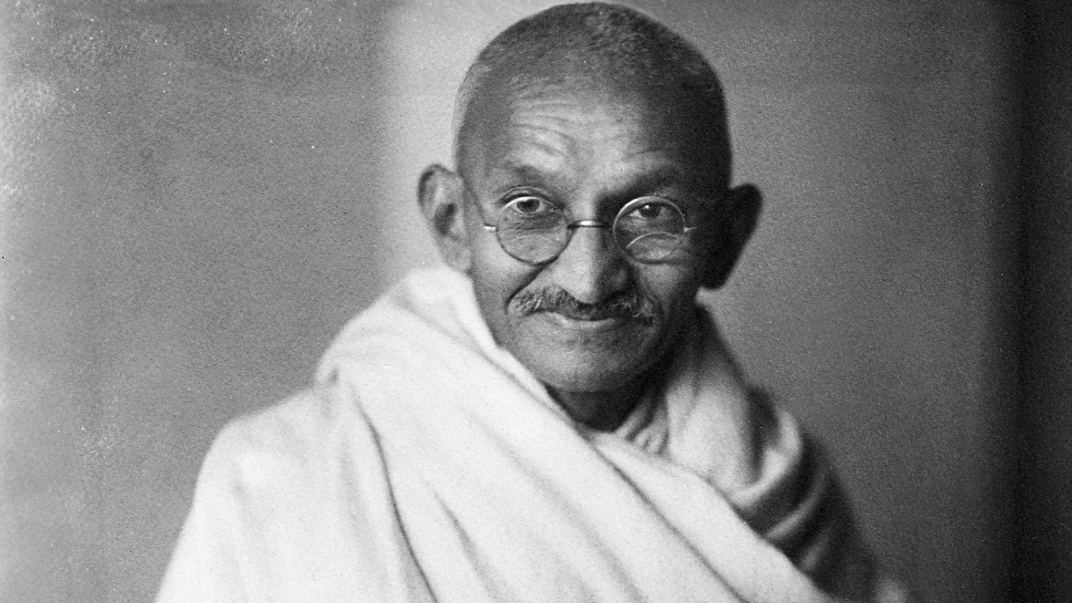

Slide 20
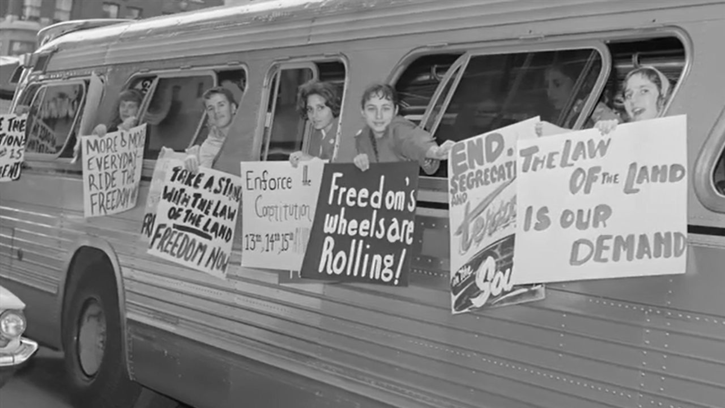

Slide 21
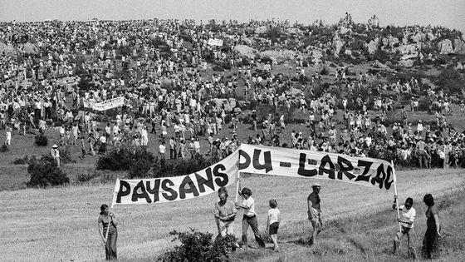

Slide 22
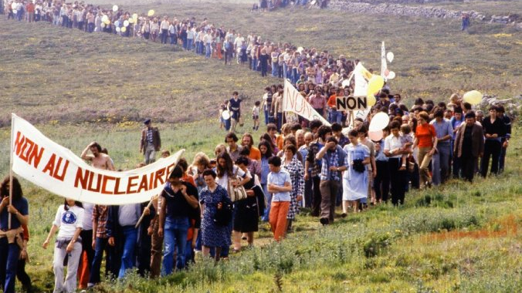

Slide 23
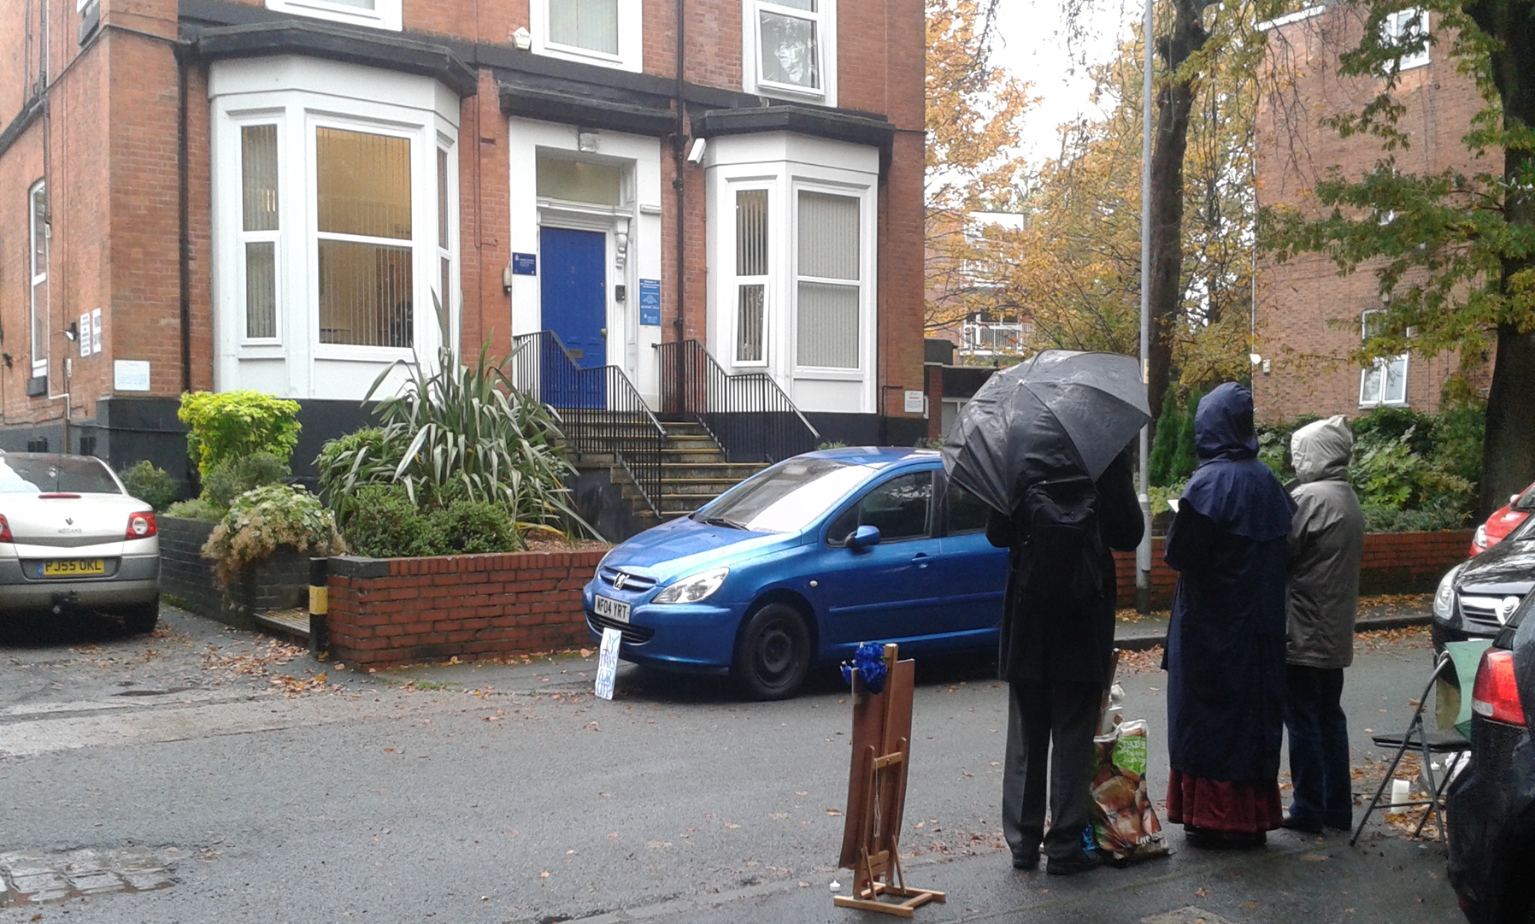

Slide 24
Cinq idées sur l’urgence écologique et la désobéissance civile
4. Justifications

Slide 25
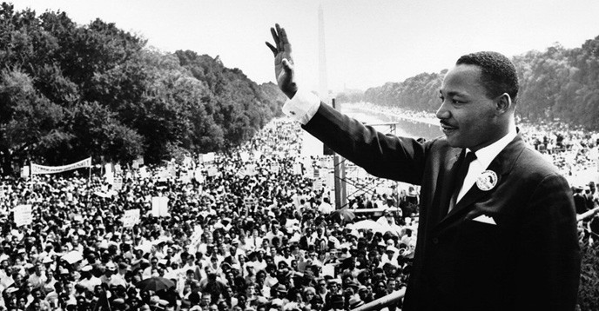
For years now, I have heard the word ‘Wait!’
This ‘Wait’ has almost always meant ‘Never’

Slide 26
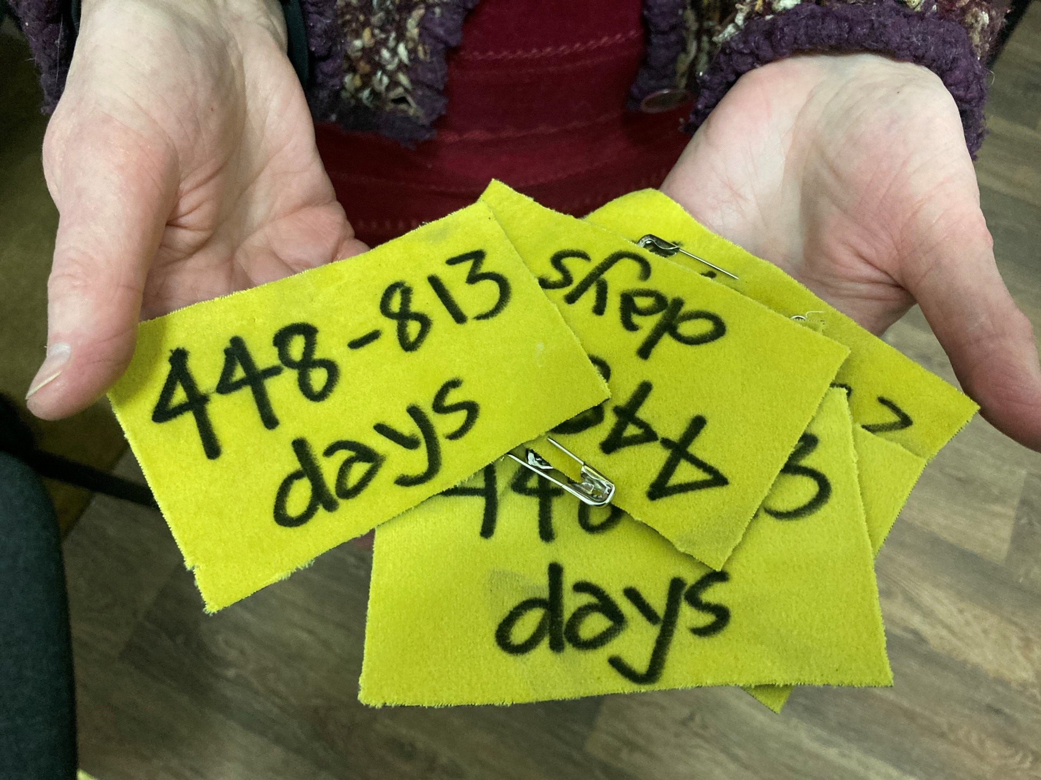
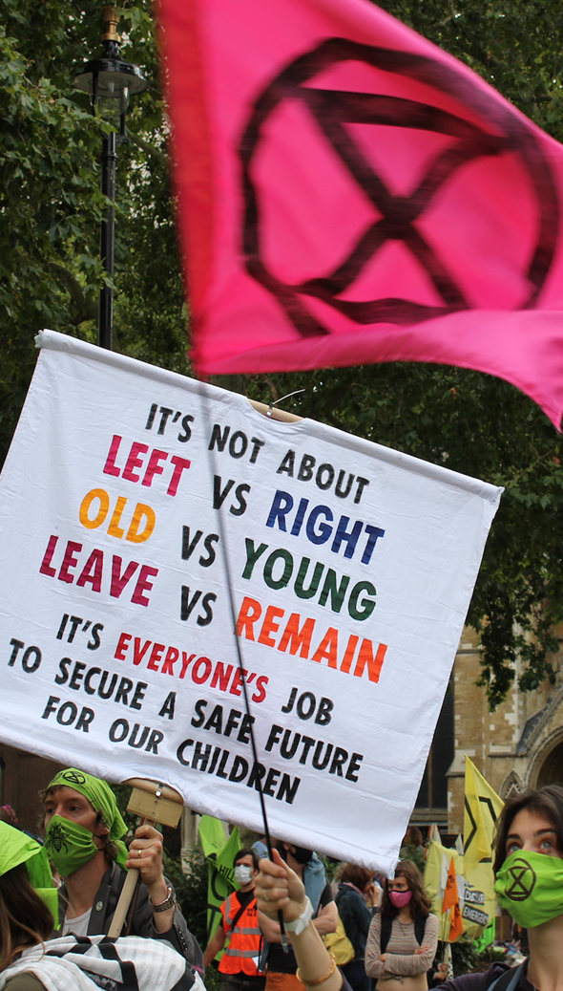

Slide 27
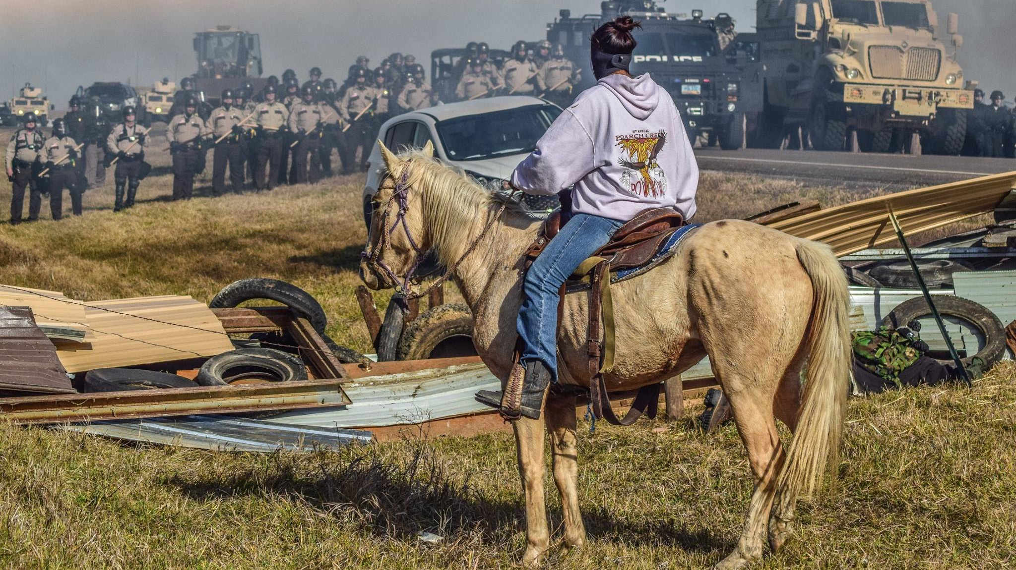

Slide 28
Cinq idées sur l’urgence écologique et la désobéissance civile
5. Punitions

Slide 29
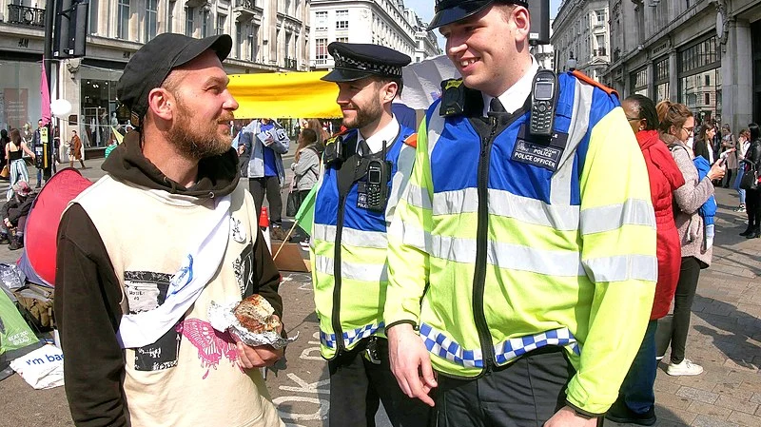
De la Police…

Slide 30
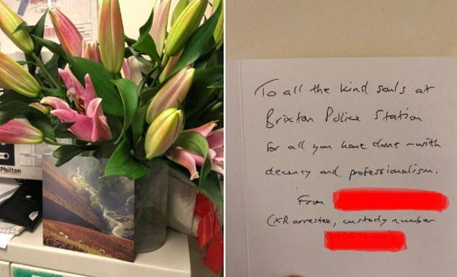

Slide 31
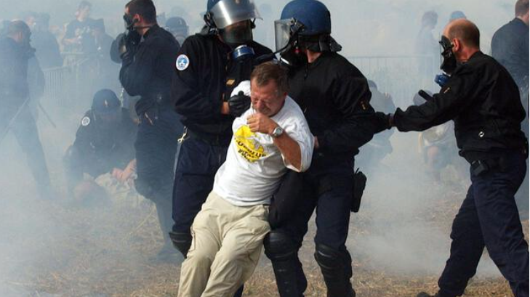

Slide 32
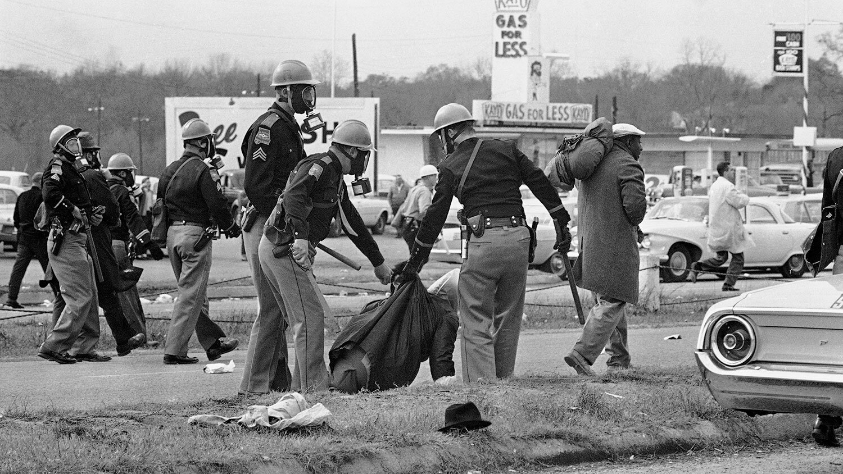
‘moral jiu jitsu’ Richard Gregg, The Power of Nonviolence, 1935

Slide 33
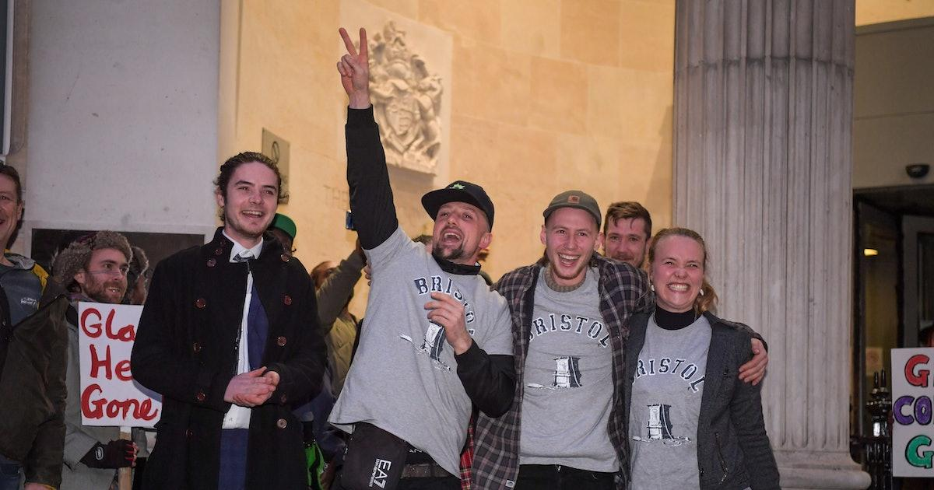
…au Tribunal

Slide 34
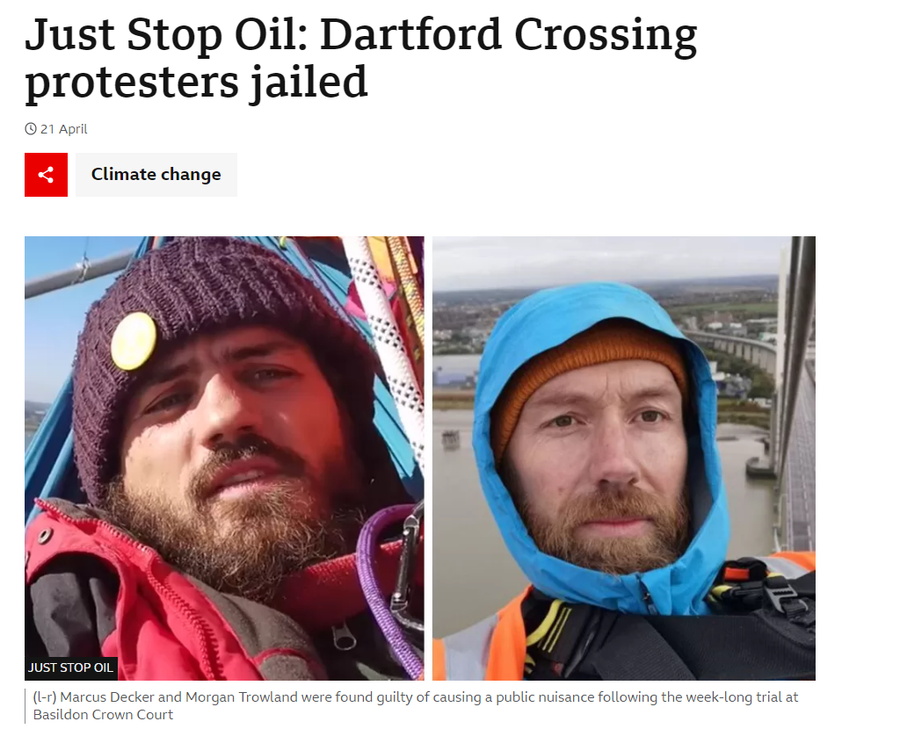
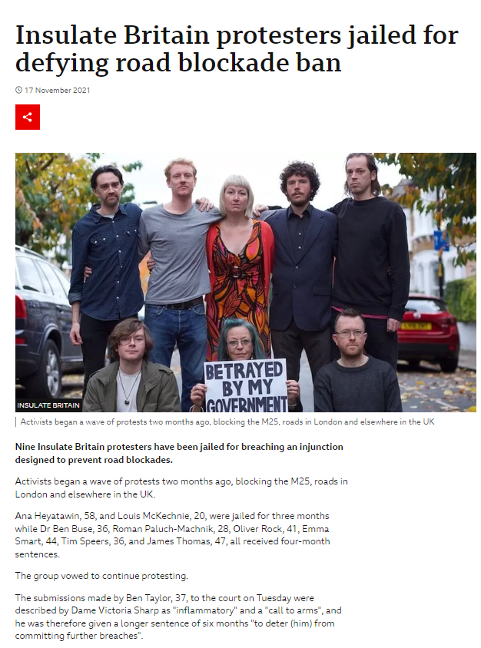

Slide 35
Cinq idées sur l’urgence écologique et la désobéissance civile
6. Conclusions

Slide 36
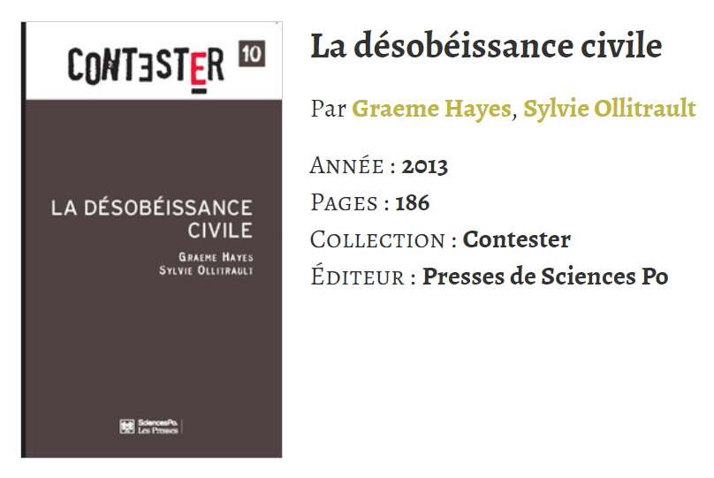
Merci!
Et pour en savoir plus...

